Slide 1
A100 Series Solar Panel Array
Notes:
This presentation was automatically generated by PowerPoint Copilot based on content found in this document: https://microsoft.sharepoint.com/teams/ContosoGreenEnergy/_layouts/15/Doc.aspx?sourcedoc=%7B6075A08A-EF92-4DD4-86ED-CF141395D32E%7D&file=Contoso%20A100%20Solar%20Panel%20Array.docx&action=default&mobileredirect=true&DefaultItemOpen=1 AI-generated content may be incorrect.

Slide 2
Agenda
Introduction
Solar Panel Specifications
Installation Guidelines
Maintenance Tips
Environmental Benefits
Cost Savings Over Time
MSRP Pricing and Discount Structure
Comparison of Panel Types
Diagrams for Clarity
Conclusion
Notes:
Agenda * Introduction * Purpose and Scope * Overview of the Document * Solar Panel Specifications * Panel Types * Efficiency Metrics * Installation Guidelines * Site Assessment * Mounting the Panels * Electrical Connections * Maintenance Tips * Environmental Benefits * Cost Savings Over Time * MSRP Pricing and Discount Structure * Base Prices * Average Pricing for a 1850 Square Foot Home * Discounts and Incentives * Monocrystalline vs. Polycrystalline * Diagrams for Clarity * Summary and Final Thoughts

Slide 3
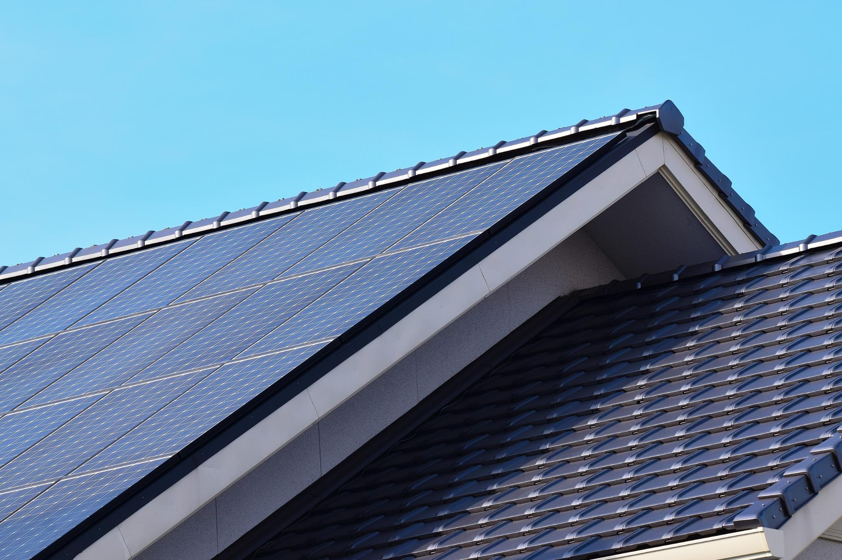
Purpose and Scope
Efficiency Metrics
Details on the efficiency of solar panels
Installation Guidelines
Step-by-step instructions for installation
Maintenance Tips
Advice on how to maintain the solar panels
Environmental Benefits
Positive impact on the environment
Potential Cost Savings
Long-term financial benefits
Comparison of Solar Panels
Differences between monocrystalline and polycrystalline panels
Notes:
This document outlines specifications for a small residential solar panel array, including efficiency, installation, maintenance, environmental benefits, and cost savings. It also compares monocrystalline and polycrystalline panels. Original Content: This document provides a detailed specification for a small residential roof-mounted solar panel array. It covers efficiency metrics, installation guidelines, maintenance tips, environmental benefits, and potential cost savings over time. Additionally, it offers a comparison between monocrystalline and polycrystalline solar panels to help homeowners make an informed decision.

Slide 4
Overview of the Document
Product Name and Series
Contoso A100 Series
Target Audience
Environmentally-conscious homeowners
Application
Small residential roof-mounted solar panel array
Home Size Compatibility
Suitable for homes with 1500-2200 square feet
Notes:
Introducing the Contoso A100 Series, a small residential roof-mounted solar panel array designed for environmentally-conscious homeowners with homes ranging from 1500 to 2200 square feet. Original Content: Contoso A100 Series Product Specification: Small Residential Roof-Mounted Solar Panel Array for 1500-2200 square feet homes A Comprehensive Guide for Environmentally-Conscious Homeowners

Slide 5
Panel Types
Monocrystalline Solar Panels
Made from a single crystal structure
High efficiency and sleek appearance
Efficiency rate of 15-20%
Polycrystalline Solar Panels
Composed of multiple silicon crystals
Generally less expensive
Efficiency rate of 13-16%
Notes:
There are two main types of solar panels: Monocrystalline and Polycrystalline. Monocrystalline panels are made from a single crystal structure, offering high efficiency and a sleek look. Polycrystalline panels, made from multiple silicon crystals, are less expensive but slightly less efficient. Original Content: Panel Types · Monocrystalline Solar Panels: Made from a single crystal structure, these panels are known for their high efficiency and sleek appearance. They typically have an efficiency rate of 15-20%. · Polycrystalline Solar Panels: Composed of multiple silicon crystals, these panels are generally less expensive but also slightly less efficient, with an efficiency rate of 13-16%.

Slide 6
Efficiency Metrics
Temperature Coefficient
Measures panel performance in high temperatures
Monocrystalline panels have a lower temperature coefficient
More efficient in hot climates
Durability and Lifespan
Both types last 25-30 years
Monocrystalline panels often have longer warranties
Energy Conversion Efficiency
Indicates percentage of sunlight converted to electricity
Monocrystalline panels: 15-20% efficiency
Polycrystalline panels: 13-16% efficiency
Notes:
Monocrystalline panels excel in high temperatures with a lower temperature coefficient. Both types last 25-30 years, but monocrystalline often have longer warranties. They also offer higher energy conversion efficiency (15-20%) compared to polycrystalline panels (13-16%). Original Content: · Temperature Coefficient: This metric measures how well the panel performs in high temperatures. Monocrystalline panels generally have a lower temperature coefficient, making them more efficient in hot climates. · Durability and Lifespan: Both panel types are built to last, with a typical lifespan of 25-30 years. However, monocrystalline panels often come with a longer warranty period. Efficiency Metrics · Energy Conversion Efficiency: This indicates the percentage of sunlight that can be converted into usable electricity. Monocrystalline panels typically offer higher efficiency rates (15-20%) compared to polycrystalline panels (13-16%).

Slide 7
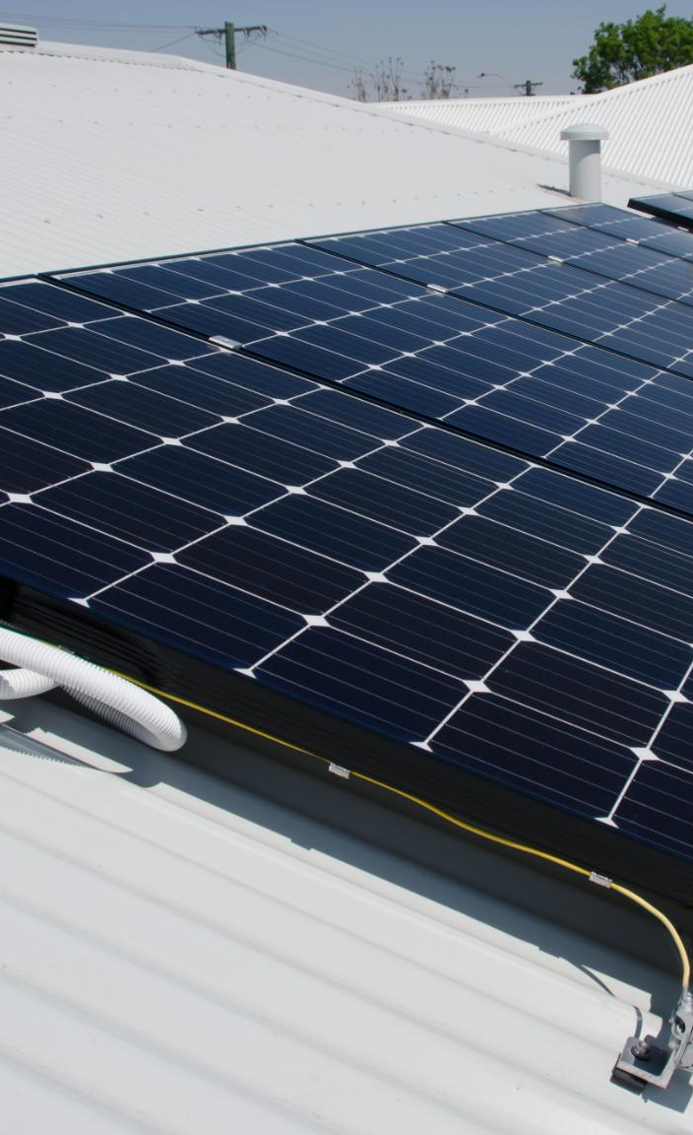
Site Assessment
Analyze Roof Structure
Ensure it can support the additional weight of the solar panels
Evaluate Roof Orientation and Tilt Angle
Maximize sunlight exposure
Identify Potential Shading Issues
Check for shading from nearby trees or buildings
Notes:
Conduct a thorough analysis of your roof structure, evaluate its orientation and tilt angle, and identify any potential shading issues for optimal solar panel installation. Original Content: Site Assessment · Conduct a thorough analysis of your roof structure to ensure it can support the additional weight of the solar panels. · Evaluate the roof's orientation and tilt angle to maximize sunlight exposure. · Identify any potential shading issues from nearby trees or buildings.

Slide 8
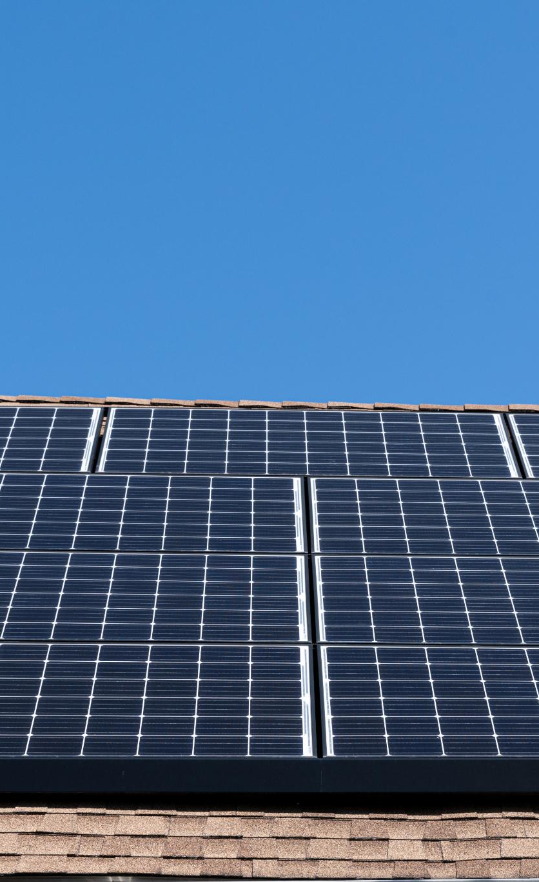
Mounting the Panels
Sturdy Mounting System
Withstand local weather conditions
High winds and heavy snow loads
Optimal Tilt Angle
Typically between 30-45 degrees
Maximize solar exposure
Proper Spacing
Allow for thermal expansion
Adequate ventilation
Notes:
When mounting solar panels, use a sturdy system to withstand weather, install at a 30-45 degree tilt for optimal exposure, and ensure proper spacing for ventilation. Original Content: Mounting the Panels · Use a sturdy mounting system that can withstand local weather conditions, including high winds and heavy snow loads. · Install the panels at an optimal tilt angle (typically between 30-45 degrees) to maximize solar exposure. · Ensure proper spacing between panels to allow for thermal expansion and adequate ventilation.

Slide 9
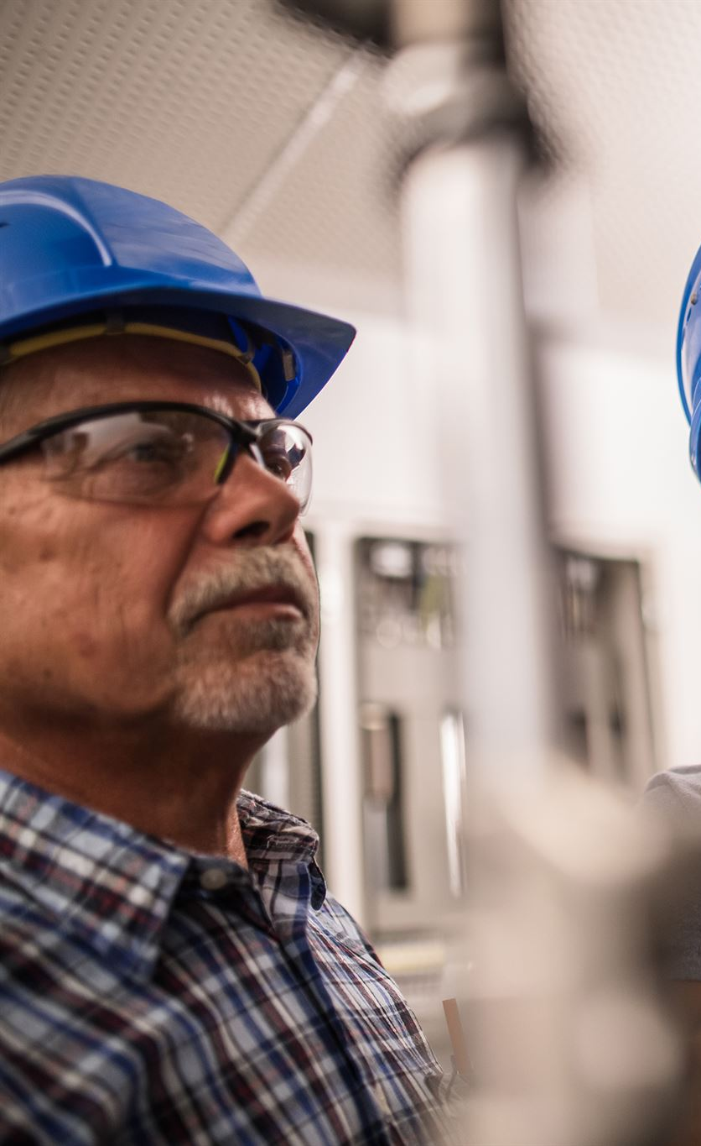
Electrical Connections
Hire a Certified Electrician
Ensures safety and compliance with local codes
Install an Inverter
Converts DC electricity to AC electricity for home use
Consider Battery Storage System
Stores energy for use during non-sunny periods
Notes:
For electrical connections, hire a certified electrician for safety and compliance. Install an inverter to convert DC to AC electricity. Consider a battery storage system for energy use during non-sunny periods. Original Content: Electrical Connections · Hire a certified electrician to handle the electrical connections to ensure safety and compliance with local codes. · Install an inverter to convert the DC electricity generated by the panels into AC electricity for home use. · Consider installing a battery storage system for energy storage and use during non-sunny periods.

Slide 10

Maintenance Tips
Regular Cleaning
Remove dirt, dust, and debris
Enhances efficiency
Inspection of Panels and Mounting System
Look for signs of damage or wear
Check after severe weather events
Electrical Connections and Inverter Check
Ensure proper functioning
Professional Inspections and Maintenance
Schedule at least once a year
Ensures optimal performance
Notes:
To maintain solar panels, clean them regularly to remove dirt and debris. Inspect for damage, especially after severe weather. Check electrical connections and the inverter periodically. Schedule professional maintenance annually for optimal performance. Original Content: · Regularly clean the panels to remove dirt, dust, and debris that can reduce efficiency. · Inspect the panels and mounting system for any signs of damage or wear, especially after severe weather events. · Check the electrical connections and inverter periodically to ensure they are functioning correctly. · Schedule professional inspections and maintenance at least once a year to ensure optimal performance.

Slide 11
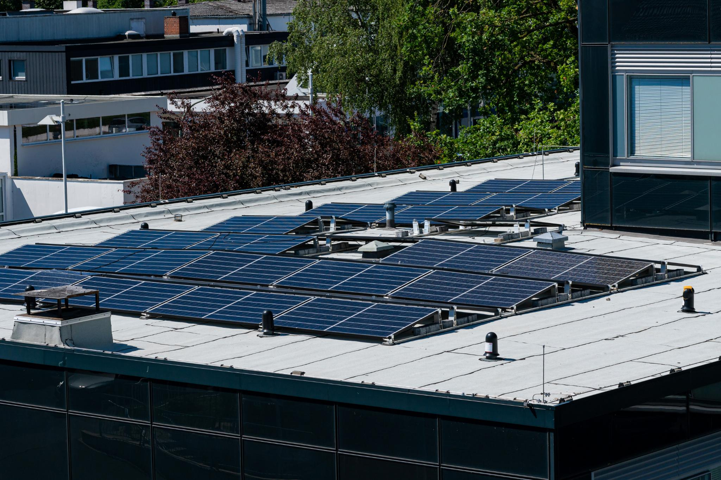
Environmental Benefits
Reduction in Carbon Footprint
Solar panels produce clean, renewable energy
Reduces reliance on fossil fuels
Lowers greenhouse gas emissions
Energy Independence
Generate your own electricity
Reduce dependence on the grid
Contribute to energy security
Sustainable Investment
Solar energy is an abundant resource
Can be harnessed without depleting natural resources
Does not harm the environment
Notes:
Solar energy offers numerous benefits including reducing carbon footprint, promoting energy independence, and being a sustainable investment. Solar panels produce clean energy, reduce reliance on fossil fuels, and lower greenhouse gas emissions. Generating your own electricity enhances energy security. Solar energy is abundant and environmentally friendly. Original Content: · Reduction in Carbon Footprint: Solar panels produce clean, renewable energy, reducing reliance on fossil fuels and lowering greenhouse gas emissions. · Energy Independence: By generating your own electricity, you reduce dependence on the grid and contribute to energy security. · Sustainable Investment: Solar energy is an abundant resource that can be harnessed without depleting natural resources or harming the environment.

Slide 12
Cost Savings Over Time
Initial Investment
Upfront cost can be significant
Incentives and tax credits available
Energy Bill Savings
Reduces or eliminates monthly electricity bills
Leads to substantial savings over time
Return on Investment
ROI typically seen within 5-10 years
Continued savings for the system's lifespan
Increased Home Value
Increases market value of the home
Makes home more attractive to buyers
Notes:
Installing solar panels offers several benefits. The initial investment is offset by incentives and tax credits. Solar panels can reduce or eliminate energy bills, providing substantial savings. Homeowners typically see a return on investment within 5-10 years. Additionally, solar panels can increase a home's market value. Original Content: · Initial Investment: While the upfront cost of solar panels can be significant, various incentives and tax credits are available to reduce the financial burden. · Energy Bill Savings: Solar panels can significantly reduce or even eliminate your monthly electricity bills, leading to substantial savings over time. · Return on Investment: Most homeowners see a return on investment within 5-10 years, with continued savings for the lifespan of the system. · Increased Home Value: Installing solar panels can increase your home's market value, making it more attractive to potential buyers.

Slide 13
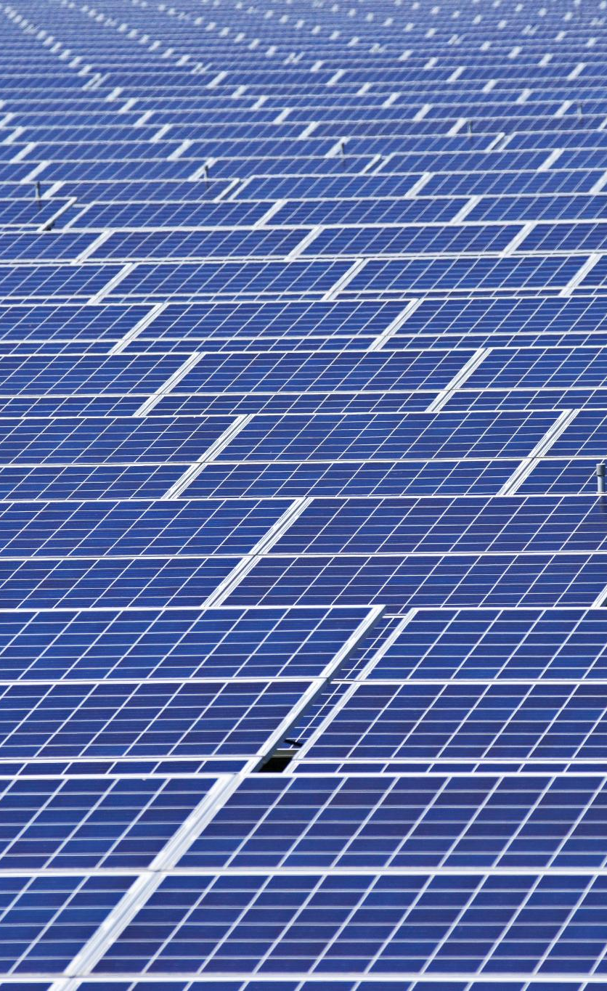
Base Prices
Monocrystalline Panels
Price range: $0.80 to $1.50 per watt
Polycrystalline Panels
Price range: $0.60 to $1.00 per watt
Notes:
The base prices for solar panels vary by type. Monocrystalline panels range from $0.80 to $1.50 per watt, while polycrystalline panels range from $0.60 to $1.00 per watt. Original Content: Base Prices: · Monocrystalline Panels: $0.80 to $1.50 per watt · Polycrystalline Panels: $0.60 to $1.00 per watt

Slide 14
Average Pricing for a 1850 Square Foot Home
Monocrystalline Panels
Cost: $16,000 to $30,000
Assumption: 20 kW system
Polycrystalline Panels
Cost: $12,000 to $20,000
Assumption: 20 kW system
Notes:
For a 1850 sq ft home, monocrystalline panels cost between $16,000 and $30,000, while polycrystalline panels range from $12,000 to $20,000, both assuming a 20 kW system. Original Content: Average Pricing for a 1850 Square Foot Home: · Monocrystalline Panels: Approximately $16,000 to $30,000 (assuming 20 kW system) · Polycrystalline Panels: Approximately $12,000 to $20,000 (assuming 20 kW system)

Slide 15
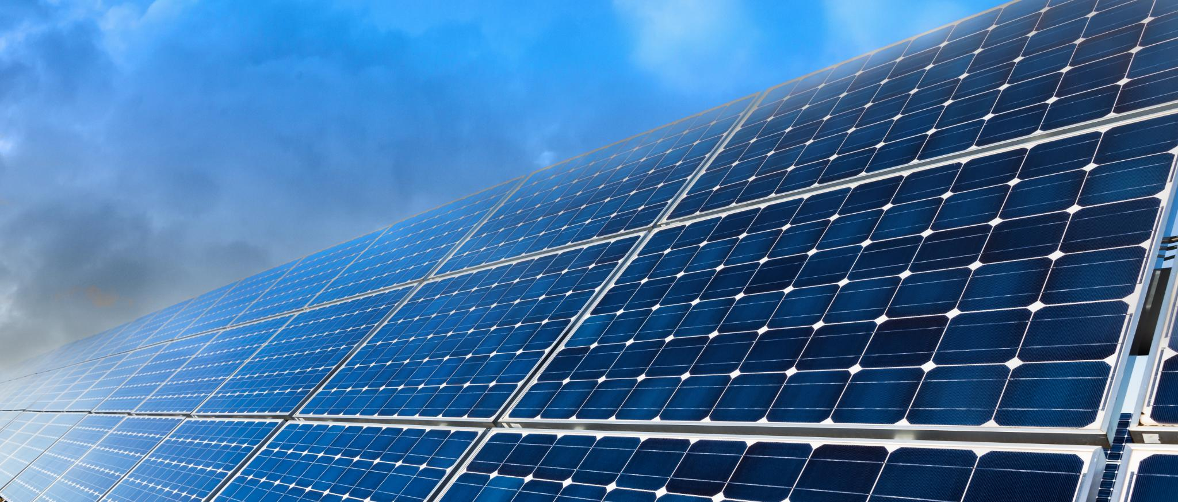
Discounts and Incentives
Bulk Purchase Discounts
Save up to 10% on orders exceeding 10 kW
Seasonal Promotions
Special discounts available during peak installation seasons
Federal and State Tax Credits
Up to 26% tax credit available through federal incentives
Additional state-specific rebates
Referral Programs
Earn discounts for referring new customers
Financing Options
Low-interest financing available through selected partners
Notes:
We offer various discounts and incentives for solar installations. Save up to 10% on bulk purchases, enjoy seasonal promotions, and benefit from federal and state tax credits. Referral programs and low-interest financing options are also available. Original Content: Discounts and Incentives: · Bulk Purchase Discounts: Save up to 10% on orders exceeding 10 kW · Seasonal Promotions: Special discounts available during peak installation seasons · Federal and State Tax Credits: Up to 26% tax credit available through federal incentives, with additional state-specific rebates · Referral Programs: Earn discounts for referring new customers · Financing Options: Low-interest financing available through selected partners

Slide 16
Comparison of Panel Types
Efficiency
Monocrystalline: 15-20%
Polycrystalline: 13-16%
Cost
Polycrystalline panels are generally less expensive
Appearance
Monocrystalline: Uniform black color
Polycrystalline: Blueish hue with a speckled appearance
Space Requirements
Monocrystalline panels require less space due to higher efficiency
Longevity
Both types have similar lifespans
Notes:
Monocrystalline panels are more efficient and require less space. They have a uniform black color and often come with longer warranties. Polycrystalline panels are less expensive and have a blueish hue with a speckled appearance. Both types have similar lifespans. Original Content: Monocrystalline vs. Polycrystalline · Efficiency: Monocrystalline panels are more efficient (15-20%) compared to polycrystalline panels (13-16%). · Cost: Polycrystalline panels are generally less expensive due to their simpler manufacturing process. · Appearance: Monocrystalline panels have a uniform black color, while polycrystalline panels have a blueish hue with a speckled appearance. · Space Requirements: Due to their higher efficiency, monocrystalline panels require less space to generate the same amount of electricity as polycrystalline panels. · Longevity: Both types have similar lifespans, but monocrystalline panels often come with longer warranties.

Slide 17
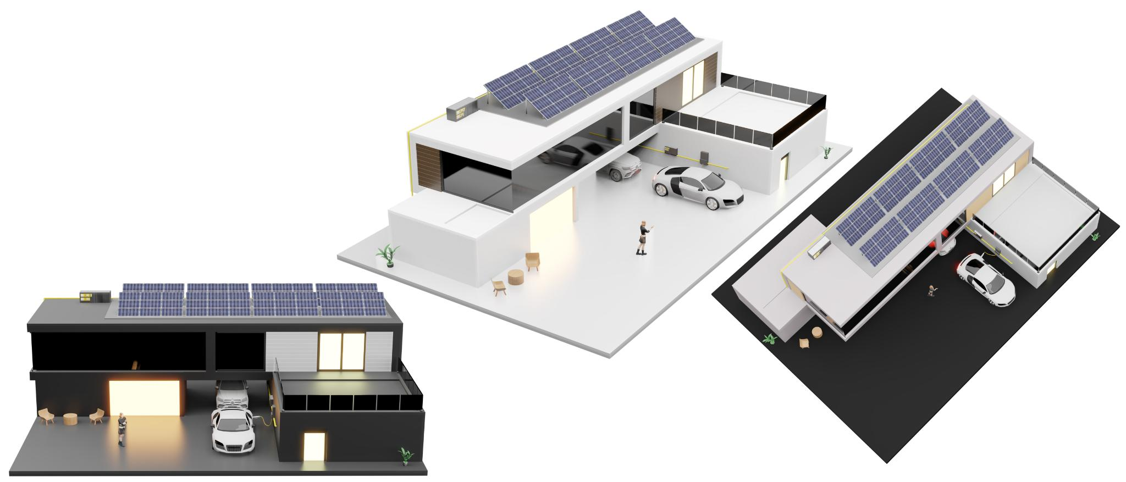
Diagrams for Clarity
Solar Panel Installation
Steps and components for residential roof-mounted solar panel array
Electrical Connections
Setup including inverter and battery storage system
Comparison of Panel Types
Differences between monocrystalline and polycrystalline solar panels
Notes:
This slide covers solar panel installation, including steps and components for a roof-mounted array, electrical connections with inverter and battery storage, and a comparison of monocrystalline and polycrystalline panels. Original Content: · Solar Panel Installation: · Diagram illustrating the steps and components involved in installing a residential roof-mounted solar panel array. · Electrical Connections: · Diagram showing the electrical connection setup, including the inverter and battery storage system. · Comparison of Panel Types: · Diagram comparing the key differences between monocrystalline and polycrystalline solar panels.

Slide 18
Conclusion
Environmental Impact
Reduces carbon footprint
Promotes sustainable living
Energy Independence
Decreases reliance on grid power
Ensures a stable energy supply
Cost Savings
Lowers energy bills
Potential for government incentives
Efficiency Metrics
Installation Guidelines
Maintenance Tips
Notes:
Investing in residential solar panels helps reduce carbon footprint, achieve energy independence, and save on costs. Understand efficiency metrics, follow installation guidelines, and maintain regularly for maximum benefits. Original Content: Conclusion Investing in a small residential roof-mounted solar panel array is a smart choice for environmentally-conscious homeowners looking to reduce their carbon footprint, achieve energy independence, and save on energy costs. By understanding the efficiency metrics, installation guidelines, and maintenance tips outlined in this document, you can make an informed decision and maximize the benefits of your solar investment.

